Slide 1
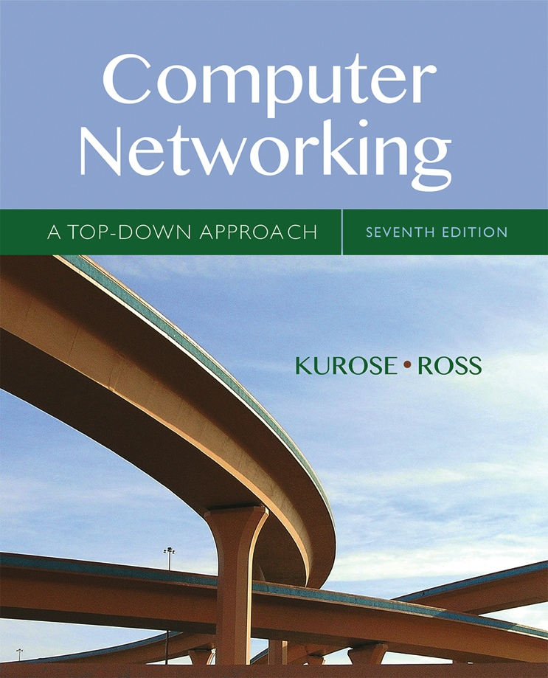

Chapter 5
Network Layer:
The Control Plane
A note on the use of these Powerpoint slides:
We’re making these slides freely available to all (faculty, students, readers). They’re in PowerPoint form so you see the animations; and can add, modify, and delete slides (including this one) and slide content to suit your needs. They obviously represent a lot of work on our part. In return for use, we only ask the following:
Computer Networking: A Top Down Approach
If you use these slides (e.g., in a class) that you mention their source (after all, we’d like people to use our book!)
If you post any slides on a www site, that you note that they are adapted from (or perhaps identical to) our slides, and note our copyright of this material.
Thanks and enjoy! JFK/KWR
All material copyright 1996-2016
J.F Kurose and K.W. Ross, All Rights Reserved
7th edition
Jim Kurose, Keith Ross
Pearson/Addison Wesley
April 2016

Slide 2
Chapter 5: network layer control plane
chapter goals: understand principles behind network control plane
traditional routing algorithms
SDN controlllers
Internet Control Message Protocol
network management
and their instantiation, implementation in the Internet:
OSPF, BGP, OpenFlow, ODL and ONOS controllers, ICMP, SNMP

Slide 3
Chapter 5: outline
5.1 introduction
5.2 routing protocols
link state
distance vector
5.3 intra-AS routing in the Internet: OSPF
5.4 routing among the ISPs: BGP
5.5 The SDN control plane
5.6 ICMP: The Internet Control Message Protocol
5.7 Network management and SNMP

Slide 4
Network-layer functions
Recall: two network-layer functions:
forwarding: move packets from router’s input to appropriate router output
data plane
routing: determine route taken by packets from source to destination
control plane
Two approaches to structuring network control plane:
per-router control (traditional)
logically centralized control (software defined networking)

Slide 5

Per-router control plane
Individual routing algorithm components in each and every router interact with each other in control plane to compute forwarding tables
Routing
Algorithm
control
plane
data
plane

Slide 6
Logically centralized control plane
A distinct (typically remote) controller interacts with local control agents (CAs) in routers to compute forwarding tables
Remote Controller
control
plane
data
plane
CA
CA
CA
CA
CA

Slide 7
Chapter 5: outline
5.1 introduction
5.2 routing protocols
link state
distance vector
5.3 intra-AS routing in the Internet: OSPF
5.4 routing among the ISPs: BGP
5.5 The SDN control plane
5.6 ICMP: The Internet Control Message Protocol
5.7 Network management and SNMP

Slide 8
Routing protocols
Routing protocol goal: determine “good” paths (equivalently, routes), from sending hosts to receiving host, through network of routers
path: sequence of routers packets will traverse in going from given initial source host to given final destination host
“good”: least “cost”, “fastest”, “least congested”
routing: a “top-10” networking challenge!

Slide 9
Graph abstraction of the network
5
v
3
w
2
5
u
2
1
z
3
1
2
x
y
1
graph: G = (N,E)
N = set of routers = { u, v, w, x, y, z }
E = set of links ={ (u,v), (u,x), (v,x), (v,w), (x,w), (x,y), (w,y), (w,z), (y,z) }
aside: graph abstraction is useful in other network contexts, e.g.,
P2P, where N is set of peers and E is set of TCP connections

Slide 10
Graph abstraction: costs
5
c(x,x’) = cost of link (x,x’)
e.g., c(w,z) = 5
cost could always be 1, or
inversely related to bandwidth,
or inversely related to
congestion
v
3
w
2
5
u
2
1
z
3
1
2
x
y
1
cost of path (x₁, x₂, x₃,…, x_{p}) = c(x₁,x₂) + c(x₂,x₃) + … + c(x_{p-1},x_{p})
key question: what is the least-cost path between u and z ?
routing algorithm: algorithm that finds that least cost path

Slide 11
Routing algorithm classification
Q: global or decentralized information?
global:
all routers have complete topology, link cost info
“link state” algorithms
decentralized:
router knows physically-connected neighbors, link costs to neighbors
iterative process of computation, exchange of info with neighbors
“distance vector” algorithms
Q: static or dynamic?
static:
routes change slowly over time
dynamic:
routes change more quickly
  periodic update
  in response to link cost changes

Slide 12
理想的路由算法
算法必须是正确的和完整的。
算法在计算上应简单。
算法应能适应通信量和网络拓扑的变化，这就是说，要有自适应性。
算法应具有稳定性。
算法应是公平的。
算法应是最佳的。

Slide 13
关于“最佳路由”
关于“最佳路由”
不存在一种绝对的最佳路由算法。
路由选择非常复杂
需要所有节点共同协调工作的。
所谓“最佳”只能是相对于某一种特定要求下得出的较为合理的选择而已。
环境不断变化，而这种变化有时无法事先知道。
当网络发生拥塞时，很难获得所需的路由选择信息。

Slide 14
从自适应性考虑的算法分类
静态路由选择策略
  非自适应路由选择；
  不能及时适应网络状态的变化；
  简单，开销较小。
动态路由选择策略
  自适应路由选择；
  能较好地适应网络状态的变化；
  实现较为复杂，开销较大。

Slide 15
分层角度的路由选择协议
互联网
  采用自适应的（即动态的）、分布式路由选择协议。
  把整个互联网划分为许多较小的自治系统 AS，采用分层次的路由选择协议。
分为两个层次
  自治系统之间的路由选择 或 域间路由选择
  —— Interdomain Routing
  自治系统内部的路由选择 或 域内路由选择
  —— Intradomain Routing

Slide 16
自治系统基本概念
自治系统 AS (Autonomous System)
自治系统
自治系统
自治系统 AS ：
是在单一技术管理下的许多网络、IP地址以及路由器，而这些路由器使用一种自治系统内部的路由选择协议和共同的度量。每一个 AS 对其他 AS 表现出的是一个单一的和一致的路由选择策略。
R1
R1
R2
R3
R4
自治系统
自治系统

Slide 17
大类路由选择协议
内部网关协议 IGP
外部网关协议 EGP
  Interior Gateway Protocol
  在一个自治系统内部使用的路由选择协议
  常用：RIP，OSPF
  External Gateway Protocol
  在不同自治系统之间进行路由选择时使用的协议
  使用最多：BGP-4

Slide 18
大类路由选择协议
自治系统和内部网关协议、外部网关协议
自治系统 A
自治系统 B
R₁
用外部网关协议
（例如，BGP-4）
R₂
用内部网关协议
（例如，RIP）
用内部网关协议
（例如，OSPF）
自治系统之间的路由选择也叫做域间路由选择 (interdomain routing)。
自治系统内部的路由选择叫做域内路由选择 (intradomain routing) 。

Slide 19
路由算法与协议
互联网路由选择协议
域内路由选择
域间路由选择
距离向量
（Distance Vector）
链路状态
（Link State）
路径向量
（Path Vector）
RIP
OSPF
BGP-4

Slide 20
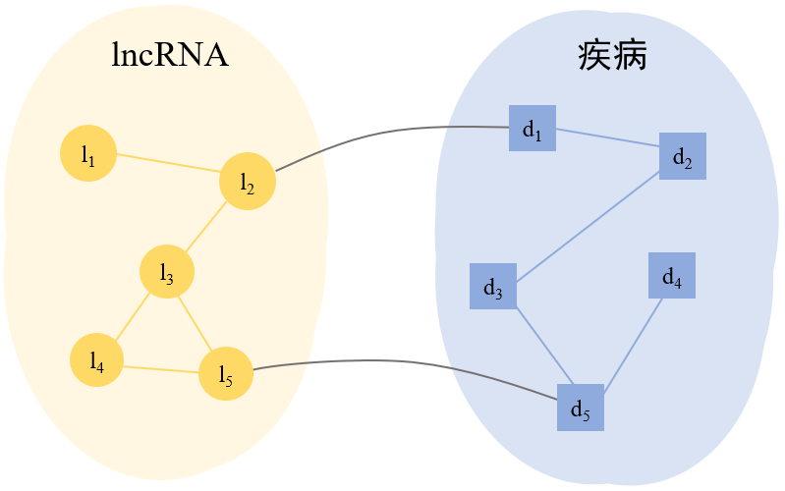
关于网络、路由的应用
生物信息学
lncRNA（Long non-coding RNAs，长链非编码RNA）是生物体内一类重要的非编码RNA，其长度超过200个核苷酸，在生命活动中起到重要调控作用。
有证据表明：lncRNA的失调、突变等异常情况与疾病的发生发展存在关联影响。
研究lncRNA-疾病关联，有助于阐明病理机制。
对于未知的lncRNA-疾病关联，使用计算方法预测，为生物医学研究提供|指导。

Slide 21







关于网络、路由的应用
社交网络
什么是社交网络？
列举你所了解的“社交网络”
基于互联网的人与人之间相互联系、信息沟通和互动娱乐的运作平台。
用户之间的信息传递
基于社交网站提供的服务，建立起的虚拟化网络，即为“社交网络”。
发布自己的状态
上传图片视频音乐等
参与某件事的讨论
记录看过的图书电影等
对音乐电影进行评分评论等

Slide 22
关于网络、路由的应用
社交网络
如何表示“社交网络”？
节点可以表示什么？
节点间的连接，可以表示什么？
朋友关系、亲属关系
支持或反对关系
关注或转发关系
拥有共同的兴趣爱好等

Slide 23
航空联程设计*
问题：
任意给出旅行的起点和终点，给出一个行程建议，使得在某些指标上“最短”?
？
方案：
典型的图的“最短路径问题”，图的顶点就是机场，两个顶点之间的边对应两个机场之间的距离。
可以用Dijkstra 算法或者动态规划算法来求解，算法复杂度为 O(n3)，其中 n 为图的顶点数。
*杜小勇，数据思维应成为计算思维 不可或缺的组成部分，CCCF，15(9)，pp.51-52，2019

Slide 24
航空联程设计*
数据思维
记录物理世界中人们旅行的选择，构建旅客、机场以及旅客航程关系的数据模型
——形成旅行大数据
根据旅行大数据，先搜索出全部的从起点到终点的旅行历史记录
用简单的统计方法，对最受欢迎的路线进行排序
优点1：计算简单
优点2：利用更复杂的数据挖掘和机器学习方法，发现和探索规律
使用过去旅客的经验选择，形成“推荐结果”
*杜小勇，数据思维应成为计算思维 不可或缺的组成部分，CCCF，15(9)，pp.51-52，2019

Slide 25
航空联程设计*
数据思维的要点
数据采集与汇聚
建模组织与管理
数据分析与挖掘
可视化与可视分析
*杜小勇，数据思维应成为计算思维 不可或缺的组成部分，CCCF，15(9)，pp.51-52，2019

Slide 26
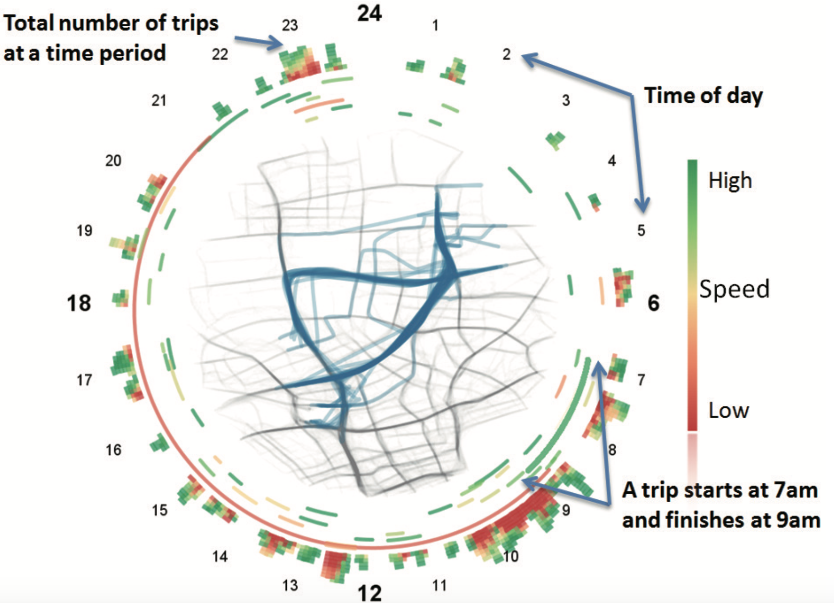
数据：出租车/GPS
问题：如何推荐路径
思路：根据历史数据，从出租车司机 在某个时间段从A地到B地所走的路径中选取一个用时最短的路径
方案：每个时间段，选择某个路径的车辆的数目，以及平均速度
结果：用户直观判断哪个路径在什么时间段比较好
论文分享：屈华民，大数据时代的可视化与协同创新，中国美术学院学报，2013，pp.21-27

Slide 27
时间的表示
车辆的多少
速度的表示
路径的表示
表示什么？
论文分享：屈华民，大数据时代的可视化与协同创新，中国美术学院学报，2013，pp.21-27

Slide 28

Senseable City实验室与法国国家高速铁路公司(SNCF)合作。
研究人们如何使用该国的高速铁路系统到达法国不同地区。
两个可视化应用程序为法国铁路运输提供了新的视角。

Slide 29
Senseable City实验室与法国国家高速铁路公司(SNCF)合作。
研究人们如何使用该国的高速铁路系统到达法国不同地区。
两个可视化应用程序为法国铁路运输提供了新的视角。

Slide 30
Chapter 5: outline
5.1 introduction
5.2 routing protocols
link state
distance vector
5.3 intra-AS routing in the Internet: OSPF
5.4 routing among the ISPs: BGP
5.5 The SDN control plane
5.6 ICMP: The Internet Control Message Protocol
5.7 Network management and SNMP

Slide 31
A link-state routing algorithm
本科经典算法Dijkstra，被证明是普遍最优了：最坏情况性能也最优！
Dijkstra’s algorithm
net topology, link costs known to all nodes
  accomplished via “link state broadcast”
  all nodes have same info
computes least cost paths from one node (‘source”) to all other nodes
  gives forwarding table for that node
iterative: after k iterations, know least cost path to k dest.’s
x
9
5
7
4
8
u
3
w
y
z
2
3
7
4
v

Slide 32
A link-state routing algorithm
notation:
c(x,y): link cost from node x to y; = ∞ if not direct neighbors
D(v): current value of cost of path from source to dest. v
p(v): predecessor node along path from source to v
N': set of nodes whose least cost path definitively known
x
9
5
7
4
8
u
3
w
y
z
2
3
7
4
v

Slide 33
Dijsktra’s algorithm
1 Initialization:
2 N' = {u}
3 for all nodes v
4 if v adjacent to u
5 then D(v) = c(u,v)
6 else D(v) = ∞
7
8 Loop
9 find w not in N' such that D(w) is a minimum
10 add w to N'
11 update D(v) for all v adjacent to w and not in N' :
12 D(v) = min( D(v), D(w) + c(w,v) )
13 /* new cost to v is either old cost to v or known
14 shortest path cost to w plus cost from w to v */
15 until all nodes in N'

Slide 34
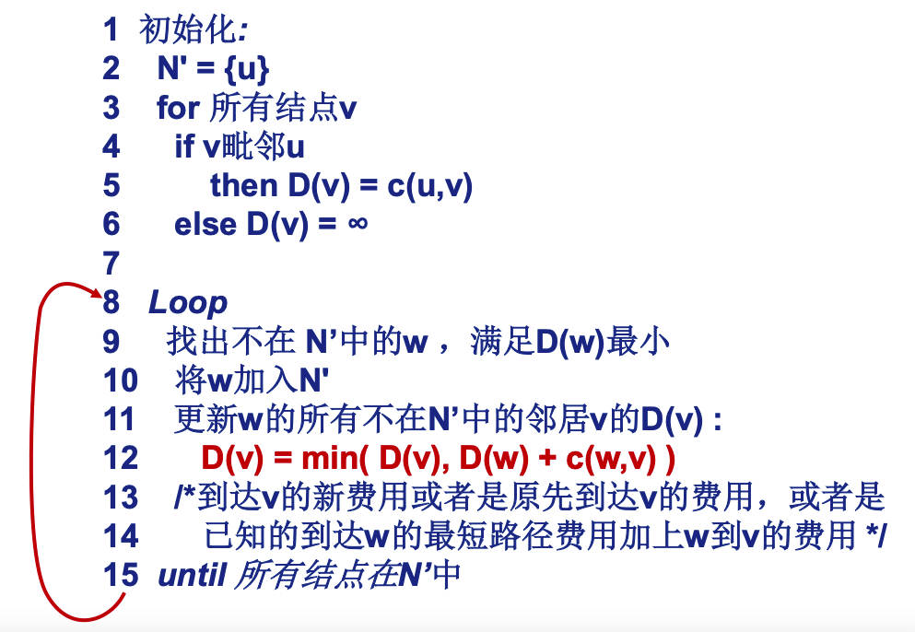
Dijsktra’s algorithm

Slide 35
Dijkstra’s algorithm: example
D(v)
p(v)
D(w)
p(w)
D(x)
p(x)
D(y)
p(y)
D(z)
p(z)
Step
N'
0
u
7,u
3,u
5,u
∞
∞
1
uw
6,w
5,u
11,w
∞
2
uwx
6,w
11,w
14,x
3
uwxv
10,v
14,x
4
uwxvy
12,y
5
uwxvyz
x
9
notes:
construct shortest path tree by tracing predecessor nodes
ties can exist (can be broken arbitrarily)
5
7
4
8
u
3
w
y
z
2
3
7
4
v

Slide 36
Dijkstra’s algorithm: another example
Step
0
1
2
3
4
5
N'
D(v),p(v)
D(w),p(w)
D(x),p(x)
D(y),p(y)
D(z),p(z)
5
v
3
w
2
5
u
2
1
z
3
1
2
x
y
1
* Check out the online interactive exercises for more examples: http://gaia.cs.umass.edu/kurose_ross/interactive/

Slide 37
Dijkstra’s algorithm: another example
Step
0
1
2
3
4
5
N'
u
ux
uxy
uxyv
uxyvw
uxyvwz
D(v),p(v)
2,u
2,u
2,u
D(w),p(w)
5,u
4,x
3,y
3,y
D(x),p(x)
1,u
D(y),p(y)
∞
2,x
D(z),p(z)
∞
∞
4,y
4,y
4,y
5
v
3
w
2
5
u
2
1
z
3
1
2
x
y
1
* Check out the online interactive exercises for more examples: http://gaia.cs.umass.edu/kurose_ross/interactive/

Slide 38
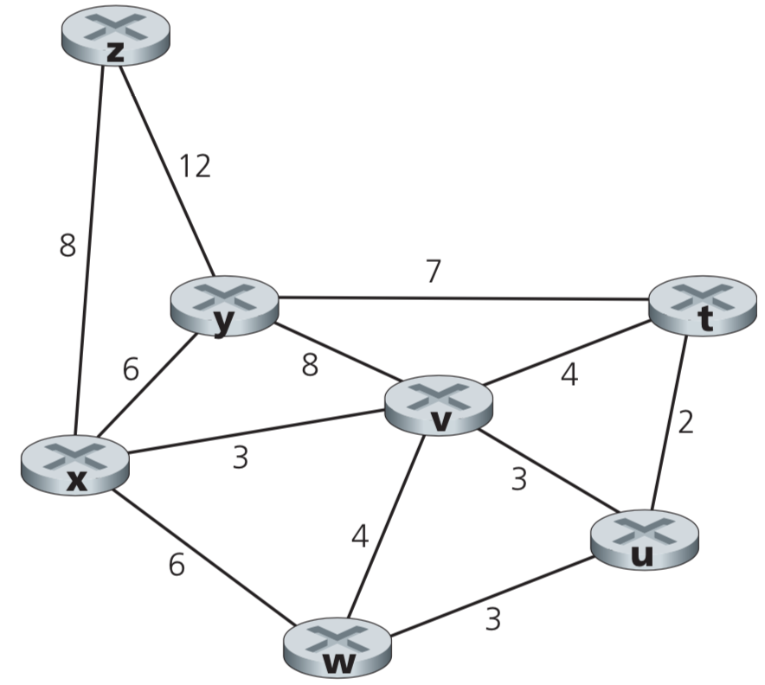
Consider the following network.
With the indicated link costs, use Dijkstra’s shortest-path algorithm to compute the shortest path from x to all network nodes.
Show how the algorithm works by computing a table similar to following table.

Slide 39
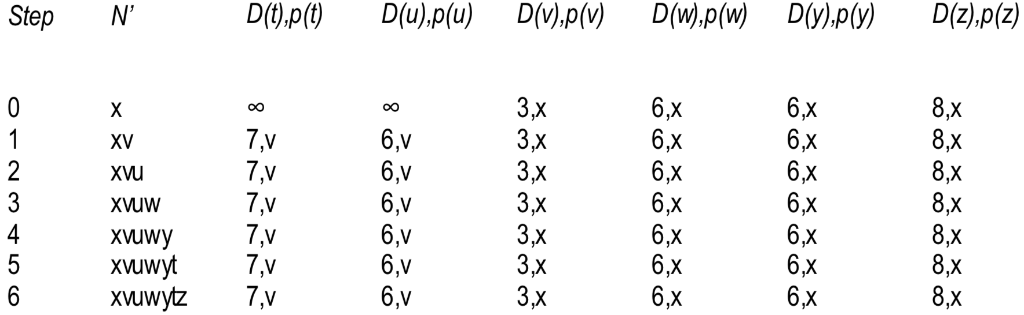

Slide 40
7个节点，从x出发，迭代7次，Step分别为0-6
Step | N’ | D(t) p(t) | D(u) p(u) | D(v) p(v) | D(w) p(w) | D(y) p(y) | D(z) p(z)
0
1
2
3
4
5
6

Slide 41
7个节点，从x出发，迭代7次，Step分别为0-6
Step | N’ | D(t) p(t) | D(u) p(u) | D(v) p(v) | D(w) p(w) | D(y) p(y) | D(z) p(z)
0 | x | ∞ | ∞ | 3 | 6 | 6 | 8
1
2
3
4
5
6

Slide 42
7个节点，从x出发，迭代7次，Step分别为0-6
Step | N’ | D(t) p(t) | D(u) p(u) | D(v) p(v) | D(w) p(w) | D(y) p(y) | D(z) p(z)
0 | x | ∞ | ∞ | 3 | 6 | 6 | 8
1 | xv
2
3
4
5
6

Slide 43
7个节点，从x出发，迭代7次，Step分别为0-6
Step | N’ | D(t) p(t) | D(u) p(u) | D(v) p(v) | D(w) p(w) | D(y) p(y) | D(z) p(z)
0 | x | ∞ | ∞ | 3,x | 6,x | 6,x | 8,x
1 | xv | 7,v | 6,v | 3,x | 6,x | 6,x | 8,x
2
3
4
5
6

Slide 44
7个节点，从x出发，迭代7次，Step分别为0-6
Step | N’ | D(t) p(t) | D(u) p(u) | D(v) p(v) | D(w) p(w) | D(y) p(y) | D(z) p(z)
0 | x | ∞ | ∞ | 3,x | 6,x | 6,x | 8,x
1 | xv | 7,v | 6,v | 3,x | 6,x | 6,x | 8,x
2
3
4
5
6

Slide 45
7个节点，从x出发，迭代7次，Step分别为0-6
Step | N’ | D(t) p(t) | D(u) p(u) | D(v) p(v) | D(w) p(w) | D(y) p(y) | D(z) p(z)
0 | x | ∞ | ∞ | 3,x | 6,x | 6,x | 8,x
1 | xv | 7,v | 6,v | 3,x | 6,x | 6,x | 8,x
2 | xvu
3
4
5
6

Slide 46
Step | N’ | D(t) p(t) | D(u) p(u) | D(v) p(v) | D(w) p(w) | D(y) p(y) | D(z) p(z)
0 | x | ∞ | ∞ | 3,x | 6,x | 6,x | 8,x
1 | xv | 7,v | 6,v | 3,x | 6,x | 6,x | 8,x
2 | xvu | 7,v | 6,v | 3,x | 6,x | 6,x | 8,x
3 | xvuw | 7,v | 6,v | 3,x | 6,x | 6,x | 8,x
4 | xvuwy | 7,v | 6,v | 3,x | 6,x | 6,x | 8,x
5 | xvuwyt | 7,v | 6,v | 3,x | 6,x | 6,x | 8,x
6 | xvuwytz | 7,v | 6,v | 3,x | 6,x | 6,x | 8,x

Slide 47
Dijkstra’s algorithm: example (2)
resulting shortest-path tree from u:
v
w
u
z
x
y
resulting forwarding table in u:
destination
link
v
(u,v)
x
(u,x)
y
(u,x)
w
(u,x)
z
(u,x)

Slide 48
Dijkstra’s algorithm, discussion
algorithm complexity: n nodes
each iteration: need to check all nodes, w, not in N
n(n+1)/2 comparisons: O(n²)
more efficient implementations possible: O(nlogn)
oscillations possible:
e.g., support link cost equals amount of carried traffic:
A
A
A
A
1
1+e
2+e
0
0
2+e
2+e
0
D
B
D
B
D
B
D
B
0
0
1+e
1
0
0
1+e
1
0
C
e
0
0
1
0
0
1
C
C
1+e
C
1
e
initially
given these costs,
find new routing….
resulting in new costs
given these costs,
find new routing….
resulting in new costs
given these costs,
find new routing….
resulting in new costs

Slide 49
Chapter 5: outline
5.1 introduction
5.2 routing protocols
link state
distance vector
5.3 intra-AS routing in the Internet: OSPF
5.4 routing among the ISPs: BGP
5.5 The SDN control plane
5.6 ICMP: The Internet Control Message Protocol
5.7 Network management and SNMP

Slide 50
Distance vector algorithm
距离向量路由算法，基于Bellman-Ford方程和动态规划思想，通过节点之间的信息交流来计算最短路径费用。
每个节点维护自己的距离向量估计，并将其通告给邻居节点。通过迭代计算，最终可以得到最佳路由。
距离向量路由算法是一个异步分布式算法，每个节点根据本地链路费用变化或收到邻居的距离向量更新来重新计算距离向量估计。
计算结果可能导致节点的距离向量发生变化，需要通告给邻居节点。
算法的主要阶段包括等待阶段、计算阶段和通告阶段。

Slide 51
Distance vector algorithm
Bellman-Ford equation (dynamic programming)
let
d_{x}(y) := cost of least-cost path from x to y
then
d_{x}(y) = min {c(x,v) + d_{v}(y) }
v
cost from neighbor v to destination y
cost to neighbor v
min taken over all neighbors v of x

Slide 52
Bellman-Ford example
5
clearly, d_{v}(z) = 5, d_{x}(z) = 3, d_{w}(z) = 3
v
3
w
2
5
u
z
B-F equation says:
2
1
3
1
2
d_{u}(z) = min { c(u,v) + d_{v}(z),
c(u,x) + d_{x}(z),
c(u,w) + d_{w}(z) }
= min {2 + 5,
1 + 3,
5 + 3} = 4
x
y
1
这三个节点是u的邻居。
node achieving minimum is next
hop in shortest path, used in forwarding table

Slide 53
Distance vector algorithm
D_{x}(y) = estimate of least cost from x to y
  x maintains distance vector D_{x} = [D_{x}(y): y є N ]
node x:
  knows cost to each neighbor v: c(x,v)
  maintains its neighbors’ distance vectors. For each neighbor v, x maintains
  D_{v} = [D_{v}(y): y є N ]

Slide 54
Distance vector algorithm
key idea:
from time-to-time, each node sends its own distance vector estimate to neighbors
when x receives new DV estimate from neighbor, it updates its own DV using B-F equation:
D_{x}(y) ← min_{v}{c(x,v) + D_{v}(y)} for each node y ∊ N
under minor, natural conditions, the estimate D_{x}(y) converge to the actual least cost d_{x}(y)

Slide 55
Distance vector algorithm
iterative, asynchronous: each local iteration caused by:
local link cost change
DV update message from neighbor
distributed:
each node notifies neighbors only when its DV changes
  neighbors then notify their neighbors if necessary
each node:
wait for (change in local link cost or msg from neighbor)
recompute estimates
if DV to any dest has changed, notify neighbors

Slide 56
D_{x}(z) = min{c(x,y) +
D_{y}(z), c(x,z) + D_{z}(z)}
= min{2+1 , 7+0} = 3
D_{x}(y) = min{c(x,y) + D_{y}(y), c(x,z) + D_{z}(y)}
= min{2+0 , 7+1} = 2
node x
table
cost to
cost to
x y z
x y z
x
0 2 7
x
0
2
3
y
y
2 0 1
from
∞
∞
∞
from
z
∞
∞
∞
z
7 1 0
node y
table
cost to
x y z
y
2
1
x
∞
∞
z
∞
2 0 1
x
from
y
7
z
∞
∞
∞
node z
table
cost to
x y z
x
∞ ∞ ∞
from
y
∞
∞
∞
z
7
1
0
time

Slide 57
D_{x}(z) = min{c(x,y) +
D_{y}(z), c(x,z) + D_{z}(z)}
= min{2+1 , 7+0} = 3
D_{x}(y) = min{c(x,y) + D_{y}(y), c(x,z) + D_{z}(y)}
= min{2+0 , 7+1} = 2
node x
table
cost to
cost to
cost to
x y z
x y z
x y z
x
0 2 7
x
0
2
3
x
0 2 3
y
y
2 0 1
from
∞
∞
∞
from
y
2 0 1
z
z
from
∞
∞
∞
7 1 0
z
3 1 0
node y
table
cost to
cost to
cost to
x y z
x y z
x y z
y
2
1
x
∞
∞
x
0 2 7
∞
2 0 1
x
0 2 3
x
z
from
y
y
2 0 1
y
7
from
from
2 0 1
z
∞
∞
∞
z
7 1 0
z
3 1 0
node z
table
cost to
cost to
cost to
x y z
x y z
x y z
x
∞ ∞ ∞
x
0 2 7
x
0 2 3
y
y
2 0 1
from
y
∞
∞
from
2 0 1
from
∞
z
z
3 1 0
z
3 1 0
7
1
0
time
time

Slide 58
Distance vector: link cost changes
link cost changes:
node detects local link cost change
updates routing info, recalculates
distance vector
if DV changes, notify neighbors
1
y
4
1
x
z
50
“good
news
travels
fast”
t₀ : y detects link-cost change, updates its DV, informs its neighbors.
t₁ : z receives update from y, updates its table, computes new least cost to x , sends its neighbors its DV.
t₂ : y receives z’s update, updates its distance table. y’s least costs do not change, so y does not send a message to z.
* Check out the online interactive exercises for more examples: http://gaia.cs.umass.edu/kurose_ross/interactive/

Slide 59
Distance vector: link cost changes
link cost changes:
node detects local link cost change
bad news travels slow - “count to infinity” problem!
44 iterations before algorithm stabilizes: see text
60
y
4
1
x
z
50
针对坏消息产生的“无穷计数”问题：
1）“毒性逆转”原理
2）其他解决办法
参考哈工大课程视频来理解
poisoned reverse:
If Z routes through Y to get to X :
  Z tells Y its (Z’s) distance to X is infinite (so Y won’t route to X via Z)
will this completely solve count to infinity problem?

Slide 60
Comparison of LS and DV algorithms
message complexity
LS: with n nodes, E links, O(nE) msgs sent
DV: exchange between neighbors only
  Convergence (收敛) time varies
speed of convergence
LS: O(n²) algorithm requires O(nE) msgs
  may have oscillations (震荡)
DV: convergence time varies
  may be routing loops
  count-to-infinity problem
robustness: what happens if router malfunctions (震荡) ?
LS:
  node can advertise incorrect link cost
  each node computes only its own table
DV:
  DV node can advertise incorrect path cost
  each node’s table used by others
    error propagate thru network

Slide 61
Chapter 4: Network Layer
Routing in the Internet
  RIP
  OSPF
  BGP

Slide 62
Intra-AS Routing
also known as Interior Gateway Protocols (IGP)
most common Intra-AS routing protocols:
  RIP: Routing Information Protocol
  OSPF: Open Shortest Path First
  IGRP: Interior Gateway Routing Protocol (Cisco proprietary)

Slide 63
RIP ( Routing Information Protocol)
included in BSD-UNIX distribution in 1982
distance vector algorithm
  distance metric: # hops (max = 15 hops), each link has cost 1
  DVs exchanged with neighbors every 30 sec in response message (aka advertisement)
  each advertisement: list of up to 25 destination subnets (in IP addressing sense)
from router A to destination subnets:
u
v
subnet hops
u 1
v 2
w 2
x 3
y 3
z 2
A
B
w
x
z
C
D
y

Slide 64
RIP: Example
z
w
x
y
A
D
B
C
routing table in router D
destination subnet next router # hops to dest
w A 2
y B 2
z B 7
x -- 1
…. …. ....

Slide 65
RIP: Example
A-to-D advertisement
dest next hops
w - 1
x - 1
z C 4
…. … ...
z
w
x
y
A
D
B
C
routing table in router D
destination subnet next router # hops to dest
w A 2
y B 2
z B 7
x -- 1
…. …. ....
A
5

Slide 66
RIP: Link Failure and Recovery
If no advertisement heard after 180 sec --> neighbor/link declared dead
  routes via neighbor invalidated
  new advertisements sent to neighbors
  neighbors in turn send out new advertisements (if tables changed)
  link failure info quickly (?) propagates to entire net
  poison reverse used to prevent ping-pong loops (infinite distance = 16 hops)

Slide 67
RIP Table processing
RIP routing tables managed by application-level process called route-d (daemon)
advertisements sent in UDP packets, periodically repeated
routed
routed
Transport
(UDP)
Transprt
(UDP)
network forwarding
(IP) table
network
(IP)
forwarding
table
link
link
physical
physical

Slide 68
Chapter 5: outline
5.1 introduction
5.2 routing protocols
link state
distance vector
5.3 intra-AS routing in the Internet: OSPF
5.4 routing among the ISPs: BGP
5.5 The SDN control plane
5.6 ICMP: The Internet Control Message Protocol
5.7 Network management and SNMP

Slide 69
Making routing scalable
our routing study thus far - idealized
all routers identical
network “flat”
… not true in practice
scale: with billions of destinations:
can’t store all destinations in routing tables!
routing table exchange would swamp links!
administrative autonomy
internet = network of networks
each network admin may want to control routing in its own network

Slide 70
Internet approach to scalable routing
aggregate routers into regions known as “autonomous systems” (AS) (a.k.a. “domains”)
intra-AS routing
routing among hosts, routers in same AS (“network”)
all routers in AS must run same intra-domain protocol
routers in different AS can run different intra-domain routing protocol
gateway router: at “edge” of its own AS, has link(s) to router(s) in other AS’es
inter-AS routing
routing among AS’es
gateways perform inter-domain routing (as well as intra-domain routing)

Slide 71
Interconnected ASes
3c
3a
2c
3b
AS3
2a
1c
2b
AS2
1a
1b
1d
AS1
forwarding table configured by both intra- and inter-AS routing algorithm
  intra-AS routing determine entries for destinations within AS
  inter-AS & intra-AS determine entries for external destinations
Intra-AS
Routing
algorithm
Inter-AS
Routing
algorithm
Forwarding
table

Slide 72
Inter-AS tasks
suppose router in AS1 receives datagram destined outside of AS1:
  router should forward packet to gateway router, but which one?
AS1 must:
learn which dests are reachable through AS2, which through AS3
propagate this reachability info to all routers in AS1
job of inter-AS routing!
3c
3a
3b
AS3
2c
other
networks
1c
2a
other
networks
1a
2b
1b
AS2
AS1
1d

Slide 73
Intra-AS Routing
内部网关协议
also known as interior gateway protocols (IGP)
most common intra-AS routing protocols:
  RIP: Routing Information Protocol
  OSPF: Open Shortest Path First (IS-IS protocol essentially same as OSPF)
  IGRP: Interior Gateway Routing Protocol (Cisco proprietary for decades, until 2016)

Slide 74
OSPF (Open Shortest Path First)
“open”: publicly available
uses link-state algorithm
  link state packet dissemination
  topology map at each node
  route computation using Dijkstra’s algorithm
router floods OSPF link-state advertisements to all other routers in entire AS
  carried in OSPF messages directly over IP (rather than TCP or UDP
  link state: for each attached link
IS-IS routing protocol: nearly identical to OSPF

Slide 75
OSPF “advanced” features
security: all OSPF messages authenticated (to prevent malicious intrusion)
multiple same-cost paths allowed (only one path in RIP)
for each link, multiple cost metrics for different TOS (e.g., satellite link cost set low for best effort ToS; high for real-time ToS)
integrated uni- and multi-cast support:
  Multicast OSPF (MOSPF) uses same topology data base as OSPF
hierarchical OSPF in large domains.

Slide 76
Hierarchical OSPF
boundary router
backbone router
backbone
area
border
routers
area 3
internal
routers
area 1
area 2

Slide 77
Hierarchical OSPF
two-level hierarchy: local area, backbone.
  link-state advertisements only in area
  each nodes has detailed area topology; only know direction (shortest path) to nets in other areas.
area border routers: “summarize” distances to nets in own area, advertise to other Area Border routers.
backbone routers: run OSPF routing limited to backbone.
boundary routers: connect to other AS’es.

Slide 78
Chapter 5: outline
5.1 introduction
5.2 routing protocols
link state
distance vector
5.3 intra-AS routing in the Internet: OSPF
5.4 routing among the ISPs: BGP
5.5 The SDN control plane
5.6 ICMP: The Internet Control Message Protocol
5.7 Network management and SNMP

Slide 79
Internet inter-AS routing: BGP
BGP (Border Gateway Protocol): the de facto inter-domain routing protocol
  “glue（胶水） that holds the Internet together”
BGP provides each AS a means to:
  eBGP: obtain subnet reachability information from neighboring ASes
  iBGP: propagate reachability information to all AS-internal routers.
  determine “good” routes to other networks based on reachability information and policy
allows subnet to advertise its existence to rest of Internet: “I am here”

Slide 80
eBGP, iBGP connections
2b
∂
2a
2c
1b
3b
2d
∂
1a
1c
3a
3c
AS 2
1d
3d
AS 1
eBGP connectivity
AS 3
iBGP connectivity
1c
gateway routers run both eBGP and iBGP protools

Slide 81
BGP basics
BGP session: two BGP routers (“peers”) exchange BGP messages over semi-permanent TCP connection:
  advertising paths to different destination network prefixes (BGP is a “path vector” protocol)
when AS3 gateway router 3a advertises path AS3,X to AS2 gateway router 2c:
  AS3 promises to AS2 it will forward datagrams towards X
AS 3
3b
AS 1
1b
3a
3c
1a
1c
AS 2
2b
3d
X
1d
2a
2c
BGP advertisement:
AS3, X
2d

Slide 82
Path attributes and BGP routes
advertised prefix includes BGP attributes
  prefix + attributes = “route”
two important attributes:
  AS-PATH: list of ASes through which prefix advertisement has passed
  NEXT-HOP: indicates specific internal-AS router to next-hop AS
Policy-based routing:
  gateway receiving route advertisement uses import policy to accept/decline path (e.g., never route through AS Y).
  AS policy also determines whether to advertise path to other other neighboring ASes

Slide 83
BGP path advertisement
AS3
3b
AS1
1b
3a
3c
1a
1c
AS2
2b
3d
X
1d
AS3,X
AS2,AS3,X
2a
2c
2d
AS2 router 2c receives path advertisement AS3,X (via eBGP) from AS3 router 3a
Based on AS2 policy, AS2 router 2c accepts path AS3,X, propagates (via iBGP) to all AS2 routers
Based on AS2 policy, AS2 router 2a advertises (via eBGP) path AS2, AS3, X to AS1 router 1c

Slide 84
BGP path advertisement
AS3
3b
AS1
1b
AS3,X
3a
3c
1a
1c
AS2
2b
3d
X
1d
AS3,X
AS2,AS3,X
2a
2c
2d
gateway router may learn about multiple paths to destination:
AS1 gateway router 1c learns path AS2,AS3,X from 2a
AS1 gateway router 1c learns path AS3,X from 3a
Based on policy, AS1 gateway router 1c chooses path AS3,X, and advertises path within AS1 via iBGP

Slide 85
BGP messages
BGP messages exchanged between peers over TCP connection
BGP messages:
  OPEN: opens TCP connection to remote BGP peer and authenticates sending BGP peer
  UPDATE: advertises new path (or withdraws old)
  KEEPALIVE: keeps connection alive in absence of UPDATES; also ACKs OPEN request
  NOTIFICATION: reports errors in previous msg; also used to close connection

Slide 86
BGP, OSPF, forwarding table entries
Q: how does router set forwarding table entry to distant prefix?
AS3
3b
AS1
1b
AS3,X
1
AS3,X
3a
3c
1a
2
1c
local link interfaces
at 1a, 1d
AS2
2b
3d
X
2
1d
1
AS3,X
AS2,AS3,X
2a
2c
physical link
2d
dest
interface
recall: 1a, 1b, 1c learn about dest X via iBGP from 1c: “path to X goes through 1c”
…
…
…
…
X
1
1d: OSPF intra-domain routing: to get to 1c, forward over outgoing local interface 1

Slide 87
BGP, OSPF, forwarding table entries
Q: how does router set forwarding table entry to distant prefix?
AS3
3b
AS1
1b
1
3a
3c
1a
2
1c
AS2
2b
3d
X
1d
2a
2c
2d
dest
interface
recall: 1a, 1b, 1c learn about dest X via iBGP from 1c: “path to X goes through 1c”
…
…
…
…
X
2
1d: OSPF intra-domain routing: to get to 1c, forward over outgoing local interface 1
1a: OSPF intra-domain routing: to get to 1c, forward over outgoing local interface 2

Slide 88
BGP route selection
router may learn about more than one route to destination AS, selects route based on:
  local preference value attribute: policy decision
  shortest AS-PATH
  closest NEXT-HOP router: hot potato routing
  additional criteria

Slide 89
Hot Potato Routing
AS3
3b
AS1
1b
3a
3c
1a
1c
AS2
2b
3d
X
1d
112
152
AS3,X
AS1,AS3,X
2a
263
2c
201
OSPF link weights
2d
2d learns (via iBGP) it can route to X via 2a or 2c
hot potato routing: choose local gateway that has least intra-domain cost (e.g., 2d chooses 2a, even though more AS hops to X): don’t worry about inter-domain cost!

Slide 90
BGP: achieving policy via advertisements
legend:
provider
B
network
X
W
A
customer
C
network:
Y
Suppose an ISP only wants to route traffic to/from its customer networks (does not want to carry transit traffic between other ISPs)
A advertises path Aw to B and to C
B chooses not to advertise BAw to C:
  B gets no “revenue” for routing CBAw, since none of C, A, w are B’s customers
  C does not learn about CBAw path
C will route CAw (not using B) to get to w

Slide 91
BGP: achieving policy via advertisements
legend:
provider
B
network
X
W
A
customer
C
network:
Y
Suppose an ISP only wants to route traffic to/from its customer networks (does not want to carry transit traffic between other ISPs)
A,B,C are provider networks
X,W,Y are customer (of provider networks)
X is dual-homed: attached to two networks
policy to enforce: X does not want to route from B to C via X
  .. so X will not advertise to B a route to C

Slide 92
Why different Intra-, Inter-AS routing ?
policy:
inter-AS: admin wants control over how its traffic routed, who routes through its net.
intra-AS: single admin, so no policy decisions needed
scale:
hierarchical routing saves table size, reduced update traffic
performance:
intra-AS: can focus on performance
inter-AS: policy may dominate over performance
MOOC 4-10 BGP2 15’

Slide 93
Chapter 5: outline
5.1 introduction
5.2 routing protocols
link state
distance vector
5.3 intra-AS routing in the Internet: OSPF
5.4 routing among the ISPs: BGP
5.5 The SDN control plane
5.6 ICMP: The Internet Control Message Protocol
5.7 Network management and SNMP

Slide 94
Software defined networking (SDN)
Internet network layer: historically has been implemented via distributed, per-router approach
  monolithic router contains switching hardware, runs proprietary implementation of Internet standard protocols (IP, RIP, IS-IS, OSPF, BGP) in proprietary router OS (e.g., Cisco IOS)
  different “middleboxes” for different network layer functions: firewalls, load balancers, NAT boxes, ..
~2005: renewed interest in rethinking network control plane

Slide 95
Recall: per-router control plane
Individual routing algorithm components in each and every router interact with each other in control plane to compute forwarding tables
Routing
Algorithm
control
plane
data
plane

Slide 96
Recall: logically centralized control plane
A distinct (typically remote) controller interacts with local control agents (CAs) in routers to compute forwarding tables
Remote Controller
control
plane
data
plane
CA
CA
CA
CA
CA

Slide 97
Software defined networking (SDN)
Why a logically centralized control plane?
easier network management: avoid router misconfigurations, greater flexibility of traffic flows
table-based forwarding (recall OpenFlow API) allows “programming” routers
  centralized “programming” easier: compute tables centrally and distribute
  distributed “programming: more difficult: compute tables as result of distributed algorithm (protocol) implemented in each and every router
open (non-proprietary) implementation of control plane

Slide 98
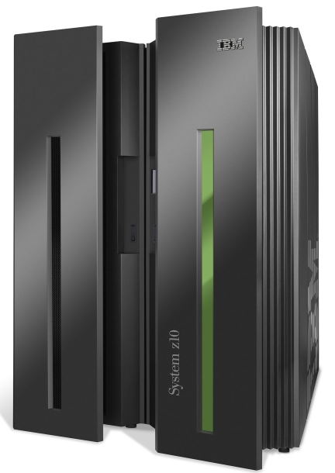
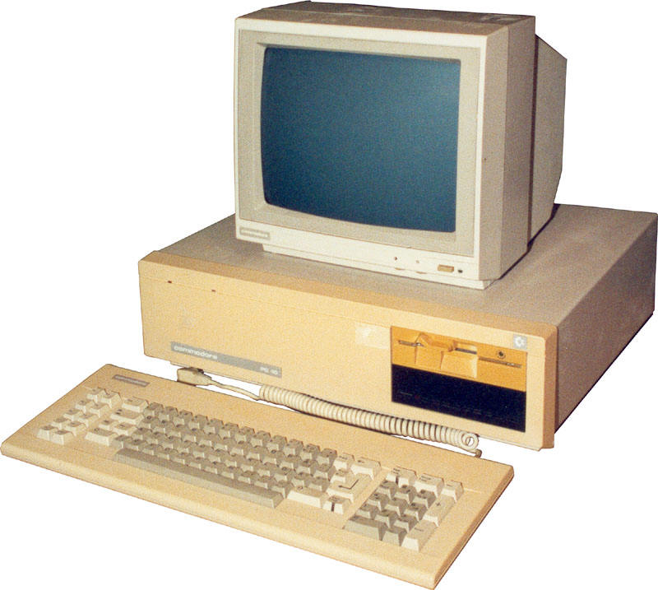
Analogy: mainframe to PC evolution*
App
App
App
App
App
App
App
App
App
App
App
Specialized
Applications
Open Interface
Specialized
Operating
System
Windows
(OS)
Linux
Mac
OS
or
or
Specialized
Hardware
Open Interface
Microprocessor
Vertically integrated
Closed, proprietary
Slow innovation
Small industry
Horizontal
Open interfaces
Rapid innovation
Huge industry
* Slide courtesy: N. McKeown

Slide 99

Traffic engineering: difficult traditional routing
5
3
v
w
5
2
u
2
1
z
3
1
2
x
y
1
Q: what if network operator wants u-to-z traffic to flow along uvwz, x-to-z traffic to flow xwyz?
A: need to define link weights so traffic routing algorithm computes routes accordingly (or need a new routing algorithm)!
Link weights are only control “knobs”: wrong!
Notes:
Note: implicit assumption here: destination based forwarding

Slide 100
Traffic engineering: difficult
5
3
v
w
5
2
u
2
1
z
3
1
2
x
y
1
Q: what if network operator wants to split u-to-z traffic along uvwz and uxyz (load balancing)?
A: can’t do it (or need a new routing algorithm)
Notes:
Note: implicit assumption here: destination based forwarding

Slide 101
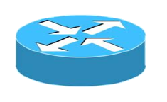
Traffic engineering: difficult
Networking 401
5
v
3
w
2
v
w
5
u
2
1
z
3
z
1
2
x
y
x
1
y
Q: what if w wants to route blue and red traffic differently?
A: can’t do it (with destination based forwarding, and LS, DV routing)
Notes:
Note: implicit assumption here: destination based forwarding

Slide 102
Software defined networking (SDN)
4. programmable control applications
…
3. control plane functions external to data-plane switches
routing
access control
load
balance
Remote Controller
control
plane
data
plane
CA
2. control, data plane separation
CA
CA
CA
CA
1: generalized“ flow-based” forwarding (e.g., OpenFlow)

Slide 103
SDN perspective: data plane switches
Data plane switches
fast, simple, commodity switches implementing generalized data-plane forwarding (Section 4.4) in hardware
switch flow table computed, installed by controller
API for table-based switch control (e.g., OpenFlow)
  defines what is controllable and what is not
protocol for communicating with controller (e.g., OpenFlow)
network-control applications
…
routing
access
control
load
balance
control
plane
northbound API
SDN Controller
(network operating system)
southbound API
data
plane
SDN-controlled switches

Slide 104
SDN perspective: SDN controller
SDN controller (network OS):
maintain network state information
interacts with network control applications “above” via northbound API
interacts with network switches “below” via southbound API
implemented as distributed system for performance, scalability, fault-tolerance, robustness
network-control applications
…
routing
access
control
load
balance
control
plane
northbound API
SDN Controller
(network operating system)
southbound API
data
plane
SDN-controlled switches

Slide 105
SDN perspective: control applications
network-control apps:
“brains” of control: implement control functions using lower-level services, API provided by SND controller
unbundled: can be provided by 3rd party: distinct from routing vendor, or SDN controller
network-control applications
…
routing
access
control
load
balance
control
plane
northbound API
SDN Controller
(network operating system)
southbound API
data
plane
SDN-controlled switches

Slide 106
Components of SDN controller
routing
access
control
load
balance
Interface layer to network control apps: abstractions API
Interface, abstractions for network control apps
…
network graph
RESTful
API
intent
Network-wide state management layer: state of networks links, switches, services: a distributed database
…
statistics
flow tables
SDN
controller
Network-wide distributed, robust state management
…
Link-state info
host info
switch info
…
communication layer: communicate between SDN controller and controlled switches
OpenFlow
SNMP
Communication to/from controlled devices

Slide 107

OpenFlow protocol
operates between controller, switch
TCP used to exchange messages
  optional encryption
three classes of OpenFlow messages:
  controller-to-switch
  asynchronous (switch to controller)
  symmetric (misc)
OpenFlow Controller

Slide 108
OpenFlow: controller-to-switch messages
Key controller-to-switch messages
features: controller queries switch features, switch replies
configure: controller queries/sets switch configuration parameters
modify-state: add, delete, modify flow entries in the OpenFlow tables
packet-out: controller can send this packet out of specific switch port
OpenFlow Controller

Slide 109
OpenFlow: switch-to-controller messages
Key switch-to-controller messages
packet-in: transfer packet (and its control) to controller. See packet-out message from controller
flow-removed: flow table entry deleted at switch
port status: inform controller of a change on a port.
OpenFlow Controller
Fortunately, network operators don’t “program” switches by creating/sending OpenFlow messages directly. Instead use higher-level abstraction at controller

Slide 110
SDN: control/data plane interaction example
Dijkstra’s link-state
Routing
1
S1, experiencing link failure using OpenFlow port status message to notify controller
4
5
…
network graph
RESTful
API
intent
2
SDN controller receives OpenFlow message, updates link status info
3
…
statistics
flow tables
…
3
Dijkstra’s routing algorithm application has previously registered to be called when ever link status changes. It is called.
Link-state info
host info
switch info
2
…
OpenFlow
SNMP
6
4
Dijkstra’s routing algorithm access network graph info, link state info in controller, computes new routes
1
s2
s1
s4
s3

Slide 111
SDN: control/data plane interaction example
Dijkstra’s link-state
Routing
4
5
…
network graph
RESTful
API
intent
5
link state routing app interacts with flow-table-computation component in SDN controller, which computes new flow tables needed
3
…
statistics
flow tables
…
Link-state info
host info
switch info
2
…
6
Controller uses OpenFlow to install new tables in switches that need updating
OpenFlow
SNMP
6
1
s2
s1
s4
s3

Slide 112
OpenDaylight (ODL) controller
…
Traffic
Engineering
ODL Lithium controller
network apps may be contained within, or be external to SDN controller
Service Abstraction Layer: interconnects internal, external applications and services
REST API
Network service apps
Basic Network Service Functions
topology
manager
switch
manager
stats
manager
Access
Control
forwarding
manager
host
manager
Service Abstraction Layer (SAL)
…
OpenFlow 1.0
SNMP
OVSDB

Slide 113
ONOS controller
…
Network
control apps
control apps separate from controller
intent framework: high-level specification of service: what rather than how
considerable emphasis on distributed core: service reliability, replication performance scaling
northbound abstractions,
protocols
REST API
Intent
hosts
paths
flow rules
topology
ONOS
distributed core
devices
links
statistics
device
link
host
flow
packet
southbound abstractions,
protocols
OpenFlow
Netconf
OVSDB

Slide 114
SDN: selected challenges
hardening the control plane: dependable, reliable, performance-scalable, secure distributed system
  robustness to failures: leverage strong theory of reliable distributed system for control plane
  dependability, security: “baked in” from day one?
networks, protocols meeting mission-specific requirements
  e.g., real-time, ultra-reliable, ultra-secure
Internet-scaling

Slide 115
Chapter 5: outline
5.1 introduction
5.2 routing protocols
link state
distance vector
5.3 intra-AS routing in the Internet: OSPF
5.4 routing among the ISPs: BGP
5.5 The SDN control plane
5.6 ICMP: The Internet Control Message Protocol
5.7 Network management and SNMP

Slide 116
  ICMP协议
  ICMP: 互联网控制报文协议
  ICMP 允许主机或路由器报告差错情况和提供有关异常情况的报告
  由主机和路由器用于网络层信息的通信
  ICMP 报文携带在IP 数据报中： IP上层协议号为1
  ICMP报文类型
  ICMP 差错报告报文
    终点不可达：不可达主机、不可达网络，无效端口、协议
  ICMP 询问报文
    回送请求/回答 (ping使用)
Notes:
注：根据RFC 6633规定，已不再使用类型值为4、10或9、15或16、17或18的报文。
目前在使用的差错报告报文：终点不可达、时间超过、参数问题、改变路由（重定向 Redirect)
目前在使用的询问报文：回送请求和回答报文、时间戳请求和回答报文

Slide 117
ICMP 报文格式 格式
0
8
16
31
类型
代码
检验和
（这 4 个字节取决于 ICMP 报文的类型）
ICMP 的数据部分（长度取决于类型）
ICMP 报文
首 部
数 据 部 分
IP 数据报
ICMP报文的前 4 个字节包含格式统一的三个字段：类型、代码、检验和
相邻的后四个字节内容与ICMP的报文类型有关
Notes:
不发送 ICMP 差错报告报文的几种情况：
对 ICMP 差错报告报文不再发送 ICMP 差错报告报文
对第一个分片的数据报片的所有后续数据报片都不发送 ICMP 差错报告报文
对具有多播地址的数据报都不发送 ICMP 差错报告报文
对具有特殊地址（如127.0.0.0 或 0.0.0.0）的数据报不发送 ICMP 差错报告报文

Slide 118
  ICMP报文类型及功能
ICMP报文类型 | 类型值 | 功能描述
差错报告报文 | 3 | 终点不可达
 | 5 | 改变路由(Redirect)
 | 11 | 时间超时
 | 12 | 参数问题
询问报文 | 8或0 | 回送(Echo)请求或应答
 | 13或14 | 时间戳(Timestamp)请求或回答
类型 代码 功能描述
0 0 回送应答 (ping)
3 0 目的网络不可达
3 1 目的主机不可达
3 2 目的协议不可达
3 3 目的端口不可达
3 6 目的网络未知
3 7 目的主机未知
8 0 回送请求 (ping)
9 0 路由通告
10 0 路由发现
11 0 TTL过期
12 0 坏的IP首部
注：根据RFC 6633规定，已不再使用类型值为4、10或9、15或16、17或18的报文。

Slide 119
差错报告报文
ICMP 差错报告报文的数据字段的内容
IP 原始数据报的数据字段
收到的 IP 原始数据报
8
字节
IP 数据报首部
ICMP 的
头部字段
IP 数据报首部
8
字节
ICMP 差错报告报文
IP首部
ICMP 差错报告报文
装入 ICMP 报文的 IP 数据报
IP 数据报
Notes:
根据RFC 6633规定下面的几种 ICMP 报文不再使用
信息请求与回答报文：15或16
掩码地址请求和回答报文：17或18
路由器询问和通告报文 ：10或9
源点抑制报文：4

Slide 120
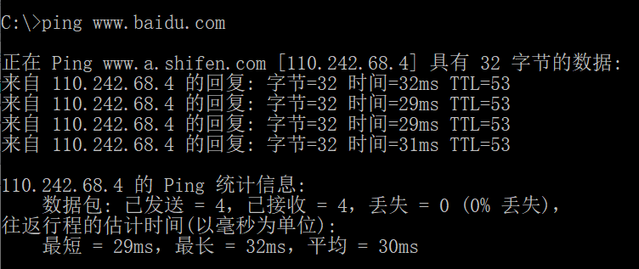
Ping和ICMP
  PING (Packet InterNet Groper)
  PING 用来测试两个主机之间的连通性
  PING 使用了 ICMP 回送请求与回送回答报文
思考：
如何利用Ping命令返回的TTL值(报文剩余跳数)，来判断对方主机操作系统的类型？
连通性
往返时延
单向转发跳数
Notes:
默认操作系统的TTL值：
1、WINDOWS NT/2000 TTL：128
2、WINDOWS 95/98 TTL：32
3、UNIX TTL：255
4、LINUX TTL：64
5、WIN7 TTL：64

Slide 121
Traceroute和ICMP
如何知道整个路径上路由器的地址？
使用TraceRT命令
3 探测分组
3 探测分组
3 探测分组
源向目的地发送一系列UDP段(不可能的端口号)
  第一个 TTL =1
  第二个 TTL=2, 等
当第n个数据报到达第n和路由器:
  路由器丢弃数据报
  并向源发送一个ICMP报文 (类型 11, 编码0)
  报文的源IP地址就是该路由器的IP地址
Notes:
在 Windows 操作系统中这个命令是 Tracert，在路由器上面的命令一般为：Traceroute
用来跟踪一个分组从源点到终点的路径
它利用 IP 数据报中的 TTL 字段和 ICMP 时间超过差错报告报文实现对从源点到终点的路径的跟踪

Slide 122
Traceroute和ICMP
C:\>tracert www.taobao.com
通过最多 30 个跃点跟踪
到 www.taobao.com.danuoyi.tbcache.com [27.211.197.171] 的路由:
1 3 ms 2 ms 4 ms 192.168.3.1
2 3 ms 6 ms 3 ms SMBSHARE [192.168.1.1]
3 6 ms 9 ms 5 ms 27.215.136.1
4 6 ms 11 ms 7 ms 61.162.199.89
5 7 ms 18 ms 21 ms 61.162.199.9
6 23 ms 29 ms 22 ms 61.156.223.69
7 28 ms 31 ms 20 ms 112.230.160.54
8 19 ms 27 ms 36 ms 60.208.64.230
9 15 ms 15 ms 16 ms 119.164.254.86
10 19 ms 13 ms 13 ms 27.211.197.171
跟踪完成。
当源收到ICMP报文，计算 RTT
Tracert针对同一RTT值执行上述过程3次
停止条件
UDP段最终到达目的地主机
目的地返回ICMP “端口不可达”分组 (类型3, 编码3)
当源得到该ICMP，停止
Windows是ping机制
Notes:
注意：
利用Tracert命令，能查看中间节点信息，可能会带来安全隐患。

Slide 123
ICMP: internet control message protocol
used by hosts & routers to communicate network-level information
  error reporting: unreachable host, network, port, protocol
  echo request/reply (used by ping)
network-layer “above” IP:
  ICMP msgs carried in IP datagrams
ICMP message: type, code plus first 8 bytes of IP datagram causing error
Type Code description
0 0 echo reply (ping)
3 0 dest. network unreachable
3 1 dest host unreachable
3 2 dest protocol unreachable
3 3 dest port unreachable
3 6 dest network unknown
3 7 dest host unknown
4 0 source quench (congestion
control - not used)
8 0 echo request (ping)
9 0 route advertisement
10 0 router discovery
11 0 TTL expired
12 0 bad IP header

Slide 124

Traceroute and ICMP
source sends series of UDP segments to destination
  first set has TTL =1
  second set has TTL=2, etc.
  unlikely port number
when datagram in nth set arrives to nth router:
  router discards datagram and sends source ICMP message (type 11, code 0)
  ICMP message include name of router & IP address
when ICMP message arrives, source records RTTs
stopping criteria:
UDP segment eventually arrives at destination host
destination returns ICMP “port unreachable” message (type 3, code 3)
source stops
3 probes
3 probes
3 probes

Slide 125
Chapter 5: outline
5.1 introduction
5.2 routing protocols
link state
distance vector
5.3 intra-AS routing in the Internet: OSPF
5.4 routing among the ISPs: BGP
5.5 The SDN control plane
5.6 ICMP: The Internet Control Message Protocol
5.7 Network management and SNMP

Slide 126
What is network management?
autonomous systems (aka “network”): 1000s of interacting hardware/software components
other complex systems requiring monitoring, control:
  jet airplane
  nuclear power plant
  others?
"Network management includes the deployment, integration
and coordination of the hardware, software, and human
elements to monitor, test, poll, configure, analyze, evaluate,
and control the network and element resources to meet the
real-time, operational performance, and Quality of Service
requirements at a reasonable cost."

Slide 127


Infrastructure for network management
definitions:
managing entity
agent
data
managing
entity
managed devices contain managed objects whose data is gathered into a Management Information Base (MIB)
data
managed device
network
management
protocol
agent
data
managed device
agent
data
managed device
agent
data
agent
data
managed device
managed device

Slide 128
SNMP protocol
Two ways to convey MIB info, commands:
managing
entity
managing
entity
request
trap msg
response
agent
data
agent
data
managed device
managed device
request/response mode
trap mode

Slide 129
SNMP protocol: message types
Message type
Function
GetRequest
GetNextRequest
GetBulkRequest
manager-to-agent: “get me data”
(data instance, next data in list, block of data)
InformRequest
manager-to-manager: here’s MIB value
SetRequest
manager-to-agent: set MIB value
Response
Agent-to-manager: value, response to
Request
Trap
Agent-to-manager: inform manager
of exceptional event

Slide 130
SNMP protocol: message formats
Get/set header
Variables to get/set
PDU
type
(0-3)
Error
Status
(0-5)
Request
ID
Error
Index
Name
Value
Name
Value
….
PDU
type
4
Trap
Type
(0-7)
Enterprise
Agent
Addr
Specific
code
Time
stamp
Name
Value
….
Trap header
Trap info
SNMP PDU
More on network management: see earlier editions of text!

Slide 131
Chapter 5: summary
we’ve learned a lot!
approaches to network control plane
  per-router control (traditional)
  logically centralized control (software defined networking)
traditional routing algorithms
  implementation in Internet: OSPF, BGP
SDN controllers
  implementation in practice: ODL, ONOS
Internet Control Message Protocol
network management
next stop: link layer!

